Slide 1
ECE 471/571 – Lecture 5
Mixture Density
09/05/14

Slide 2
Different Approaches - More Detail
Pattern Classification
Statistical Approach
Syntactic Approach
Supervised
Unsupervised
Basic concepts:
Baysian decision rule
(MPP, LR, Discri.)
Basic concepts:
Distance
Agglomerative method
Parametric learning (ML, BL)
k-means
Non-Parametric learning (kNN)
Winner-take-all
NN (Perceptron, BP)
Kohonen maps
Dimensionality Reduction
Fisher’s linear discriminant
K-L transform (PCA)
Performance Evaluation
ROC curve
TP, TN, FN, FP
Stochastic Methods
local optimization (GD)
global optimization (SA, GA)
ECE471/571, Hairong Qi

Slide 3
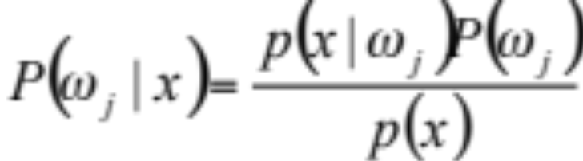
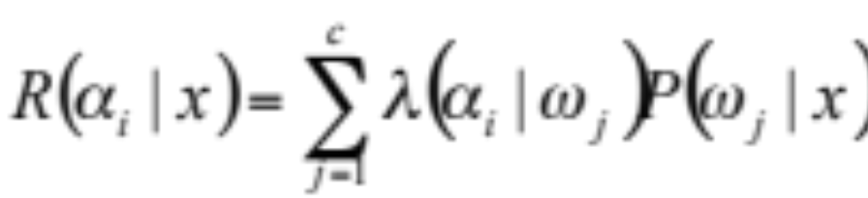
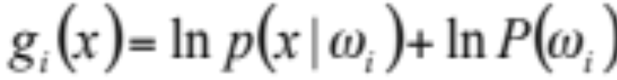
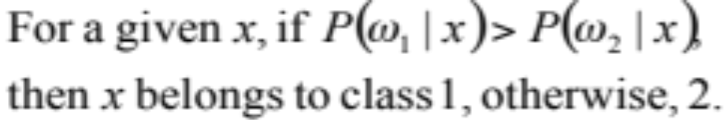
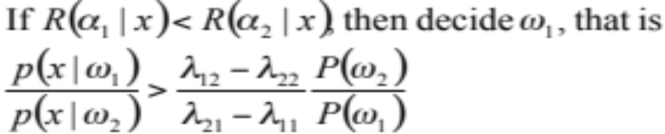
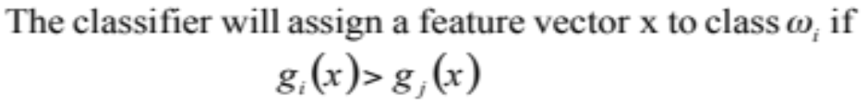
Bayes Decision Rule
Maximum
Posterior
Probability
Likelihood
Ratio
Discriminant
Function

Slide 4
Assumptions
The density is composed of two 1-D Gaussian functions
Identifiability
  Under what condition is it possible to determine the parameters?

Slide 5
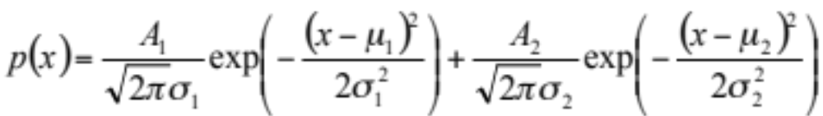
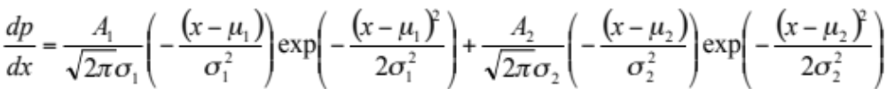
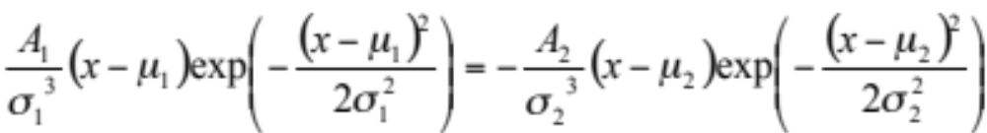
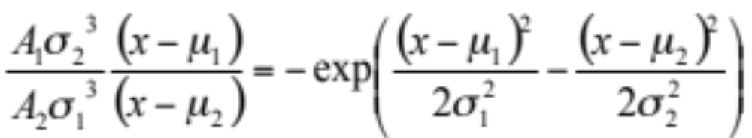
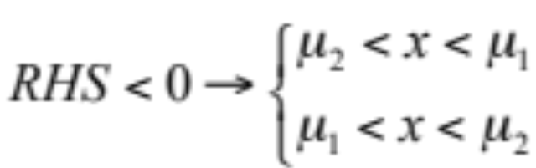
* Mixture Gaussian Density

Slide 6
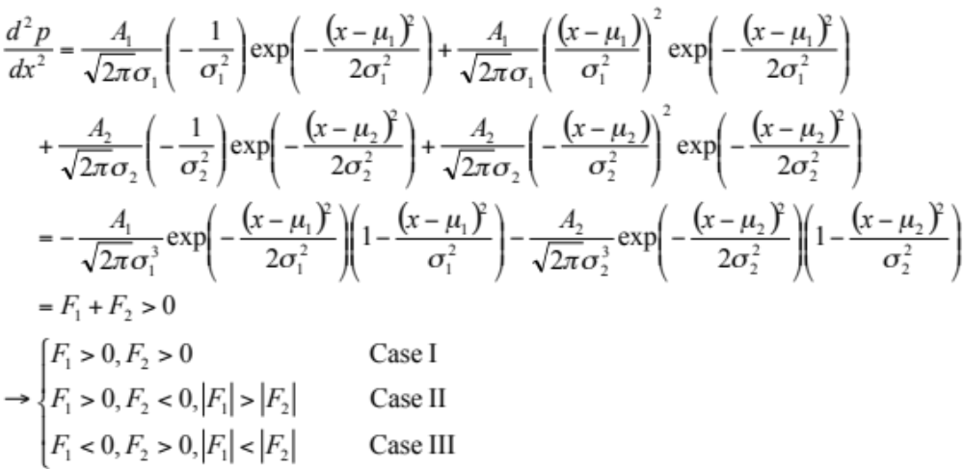
* Cont’

Slide 7
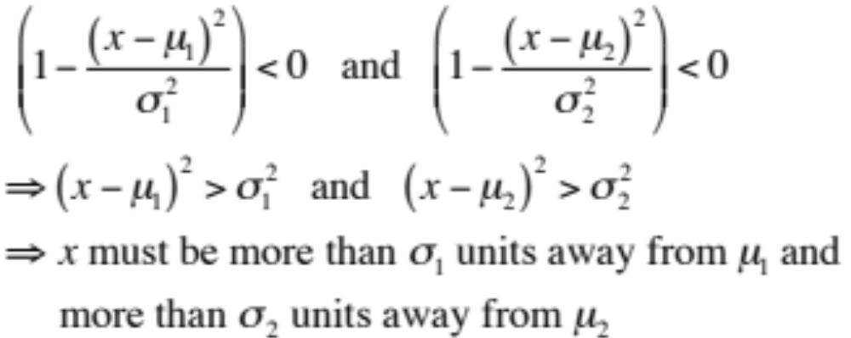
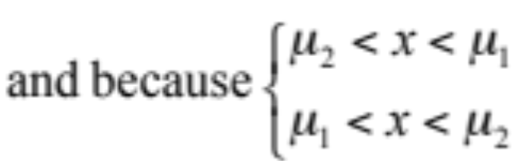
** Case I

Slide 8
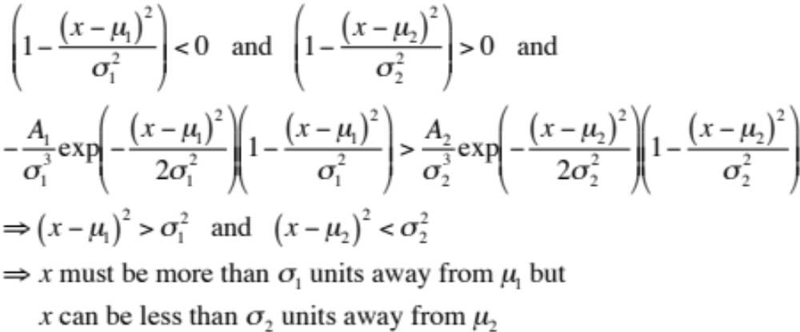
** Case II

Slide 9
Conclusion
For a 1-d function which is the sum of two Gaussian functions, two peaks will be identified if
  The mean values of the two Gaussian are far enough apart relative to their variances
  Under certain conditions, when the two mean values are not far apart, there still may be conditions under which the peaks are distinct.

Slide 10
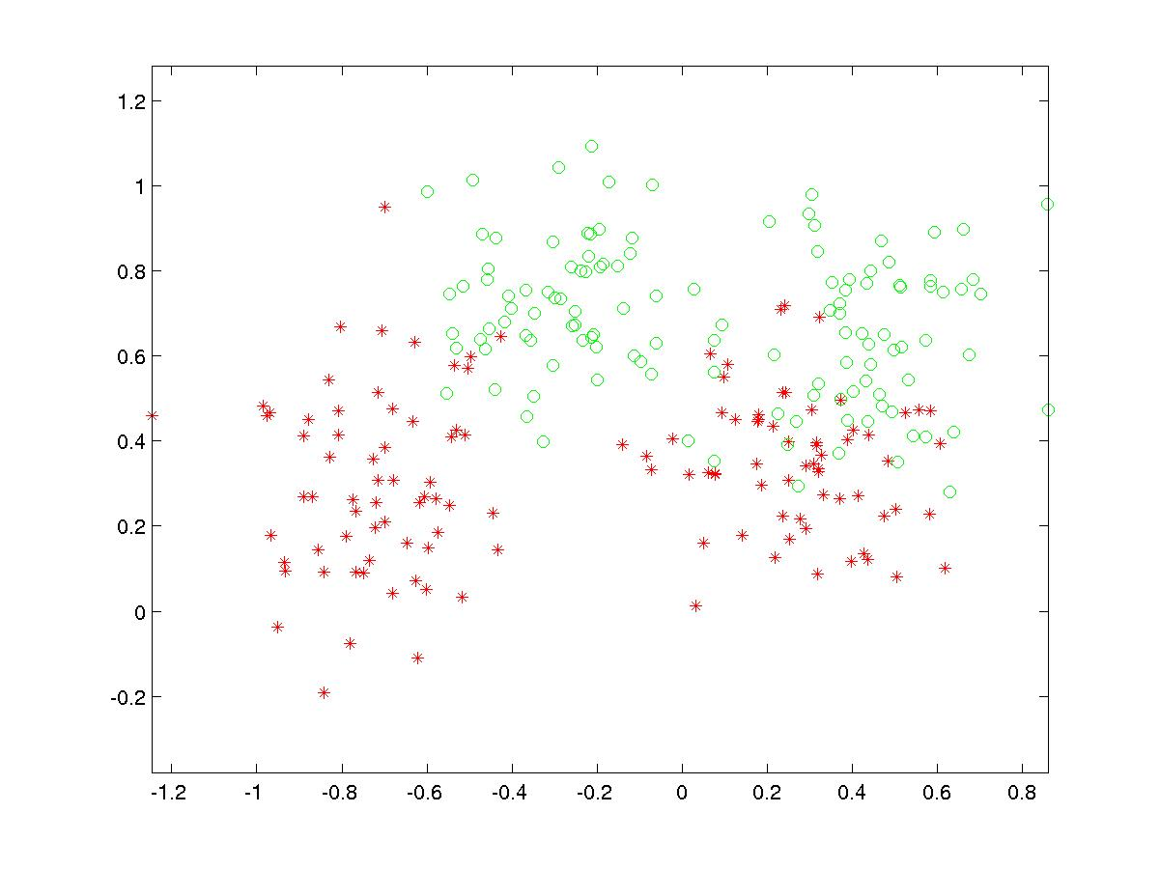
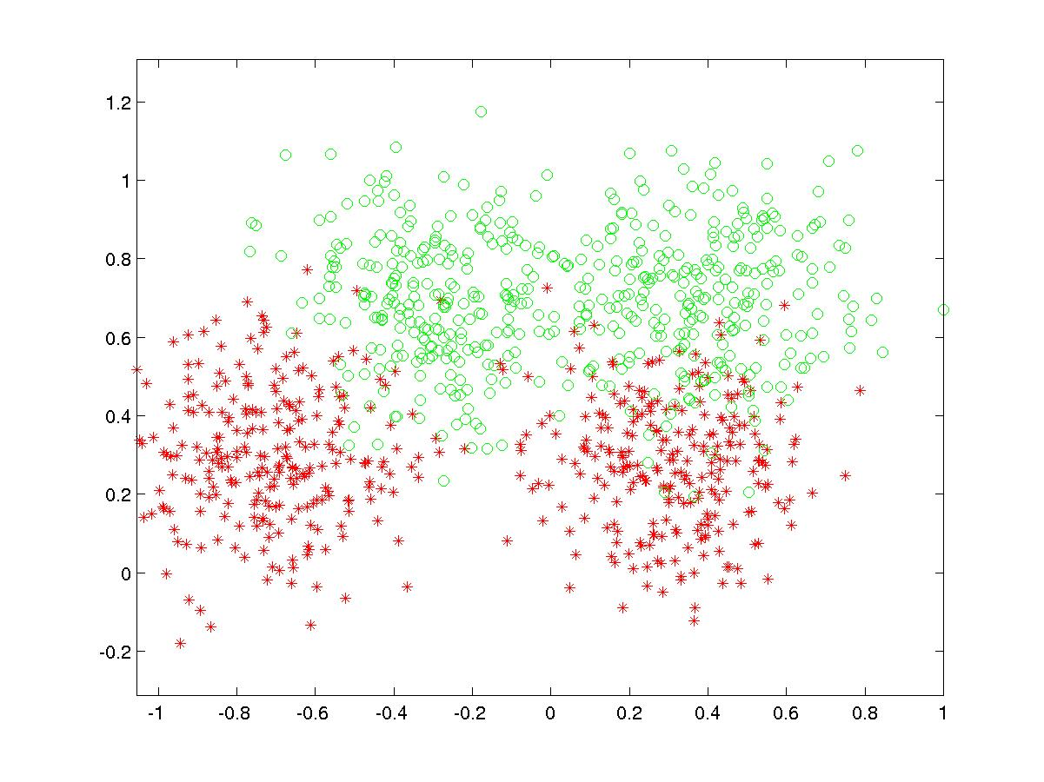
Synthetic testing set
Synthetic training set

Slide 11
